Slide 2
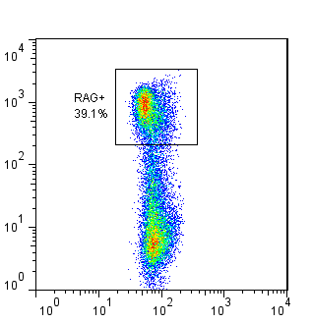
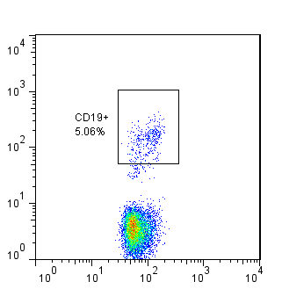
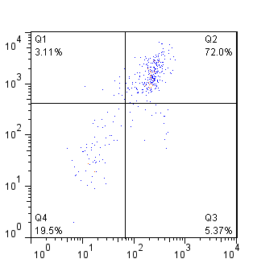
Thymus
RAG
CD19
CD8
Side Scatter
Side Scatter
CD4
Notes:
Thymus

Slide 3
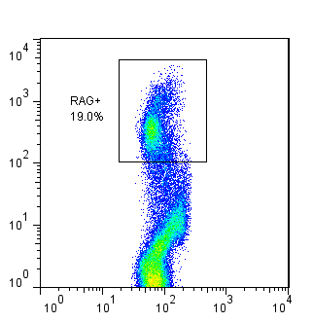
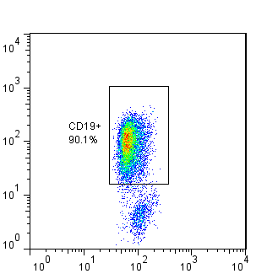
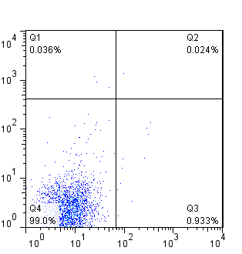
Bone Marrow
RAG
CD19
CD8
Side Scatter
Side Scatter
CD4
Notes:
Bone marrow

Slide 4
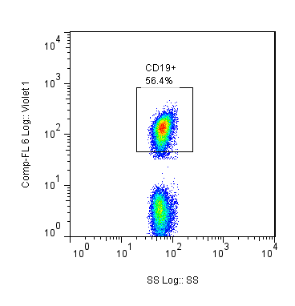
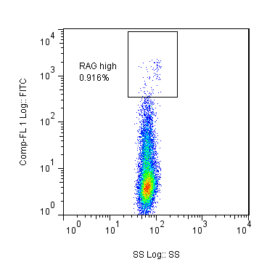
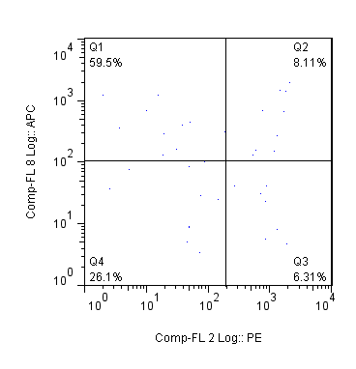
Thymus
CD19
RAG
IgM
Side Scatter
Side Scatter
TcRβ
Notes:
Thymus

Slide 5
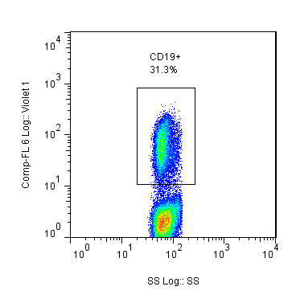
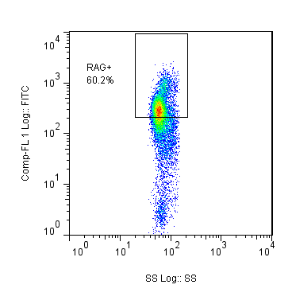
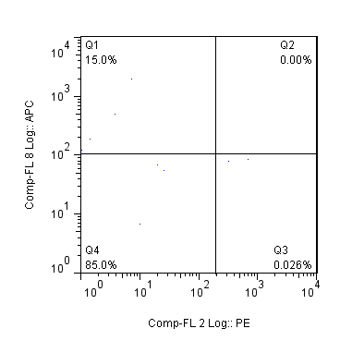
Bone Marrow
CD19
RAG
IgM
Side Scatter
Side Scatter
TcRβ
Notes:
Bone marrow

Slide 6
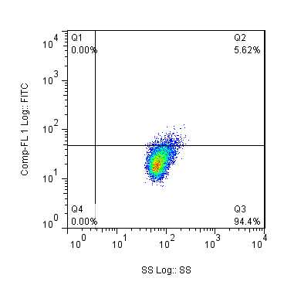
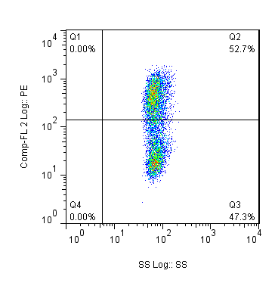
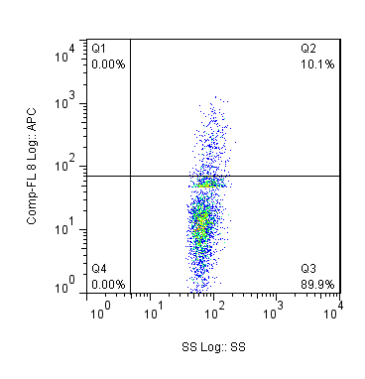
IgM
CD43
CD19
Side Scatter
Side Scatter
TcRβ
Notes:
NOD (Mouse 11 20th July)

Slide 7
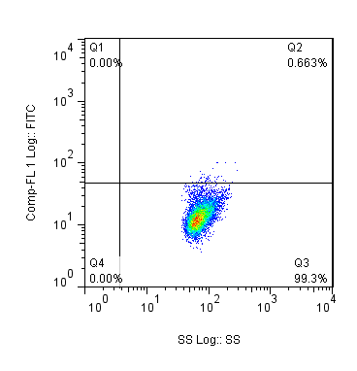
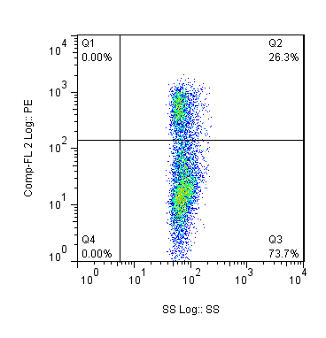
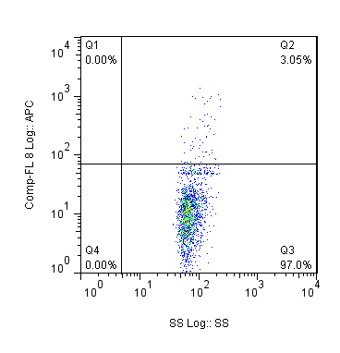
IgM
CD43
CD19
Side Scatter
Side Scatter
TcRβ
Notes:
B6

Slide 8
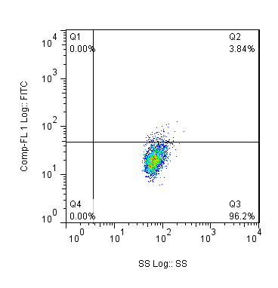
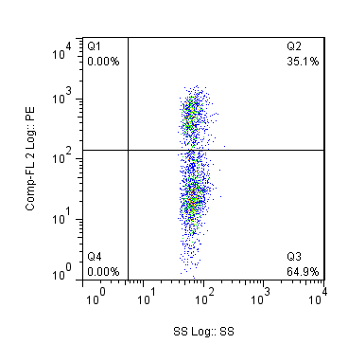
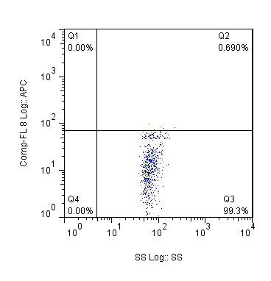
IgM
CD43
CD19
Side Scatter
Side Scatter
TcRβ

